Slide 1
ONLINE HOTEL MANAGEMENT SYSTEM

Slide 2
INTRODUCTION
Hotel Management System is a software application for managing hotel activities.It manages room booking, customer details, orders and payments.It reduces manual work and errors. It provides fast and better hotel services.

Slide 3
Problem Identification And Defination
Many hotels still use manual methods for bookings, billing, check-in/out
Leads to errors, delays, duplicate bookings
Difficulty in maintaining records
Hotel management system is developed to automate hotel operations. It helps manage room reservations, customer information, billing, staff records and reports efficiently. Reduces paperwork, saves time, improves accuracy.

Slide 4
Drawbacks of Existing System
Manual tasks take more time
Higher chance of human error
Difficult to maintain customer records
Room availability not updated instantly
Billing calculation errors- Reports take more time- Data may be lost / damaged

Slide 5
Scope of Proposed System
Manage room bookings efficiently .
Maintain customer details in secure database .
Handle check-in / check-out .
Generate accurate bills automatically .
Display room availability in real time .
Auto reports: Booking, Customer, Payment,Availability.

Slide 6
Feasibility Study
Technical: SQL Server, PostgreSQL, HTML, Python
Economic: Cost effective, reduces paperwork
Operational: Easy to use for staff
Schedule: Can be completed within planned time

Slide 7
Data Requirements
1.Customer: ID, Name, Address, Mobile, Email, ID Proof
2. Room: Number, Type, Status, Charges
3. Booking: Booking ID, Customer ID, Room No, Check-in/out, Guests
4. Payment: ID, Bill Amount, Method, Status, Date5. Employee: ID, Name, Designation, Contact
End Users
1. Admin: Manages entire system, reports
2. Receptionist: Booking, check-in/out, billing
3. Hotel Manager: Monitors operations, views reports
4. Customer: Books rooms, views booking, payment

Slide 8
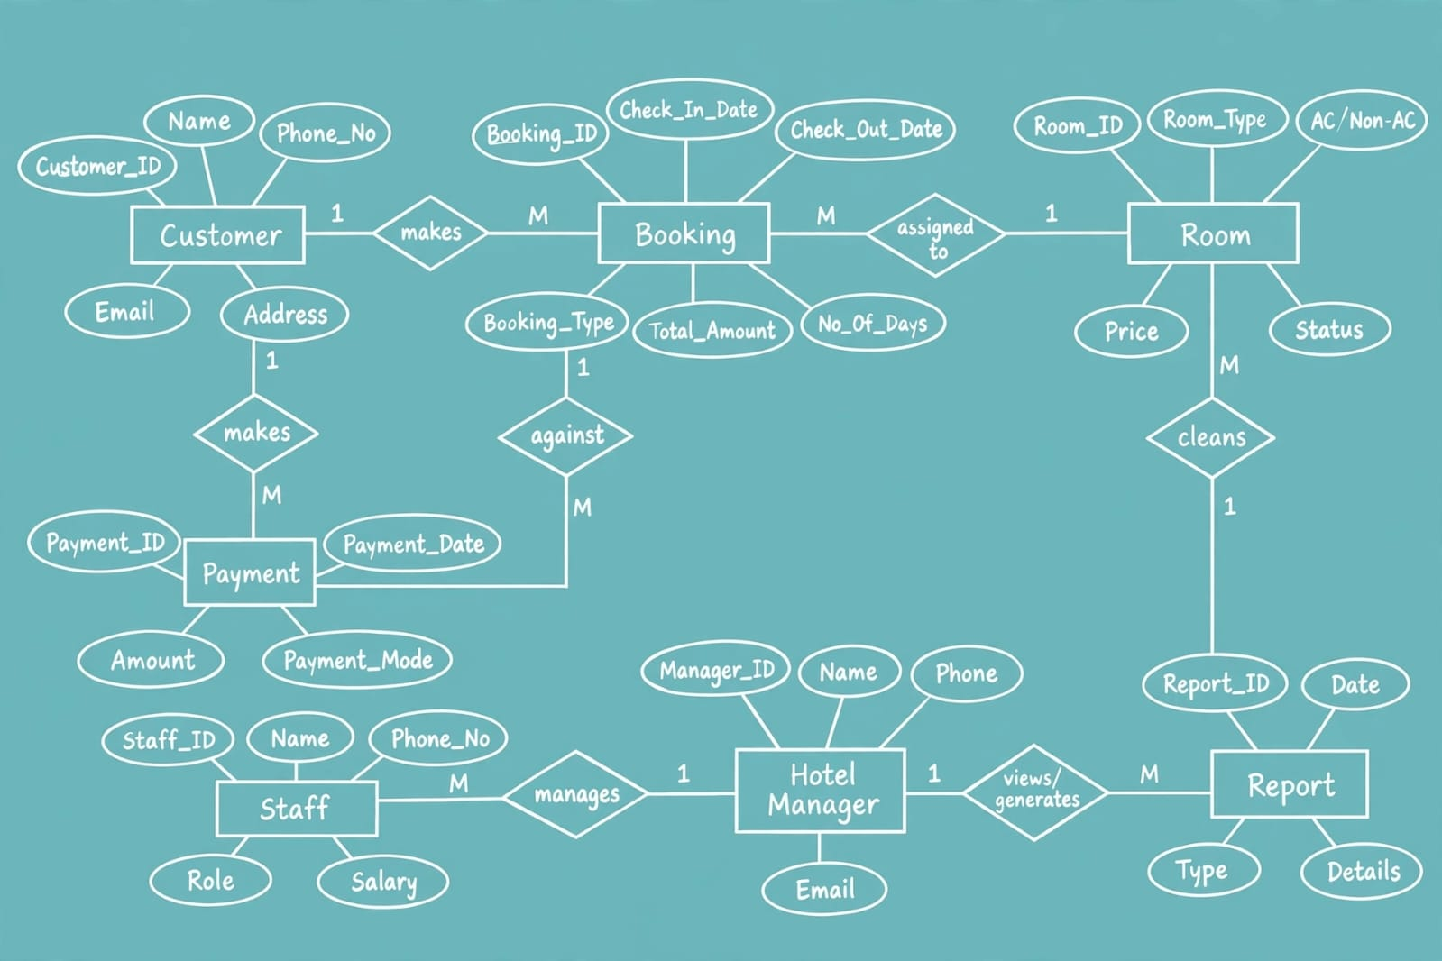
ER Diagram
Entities: Customer, Room, Booking, Payment, Staff
Relationship: Customer places Booking, Room assigned to Booking, Booking paid via Payment, Staff manages Booking

Slide 9
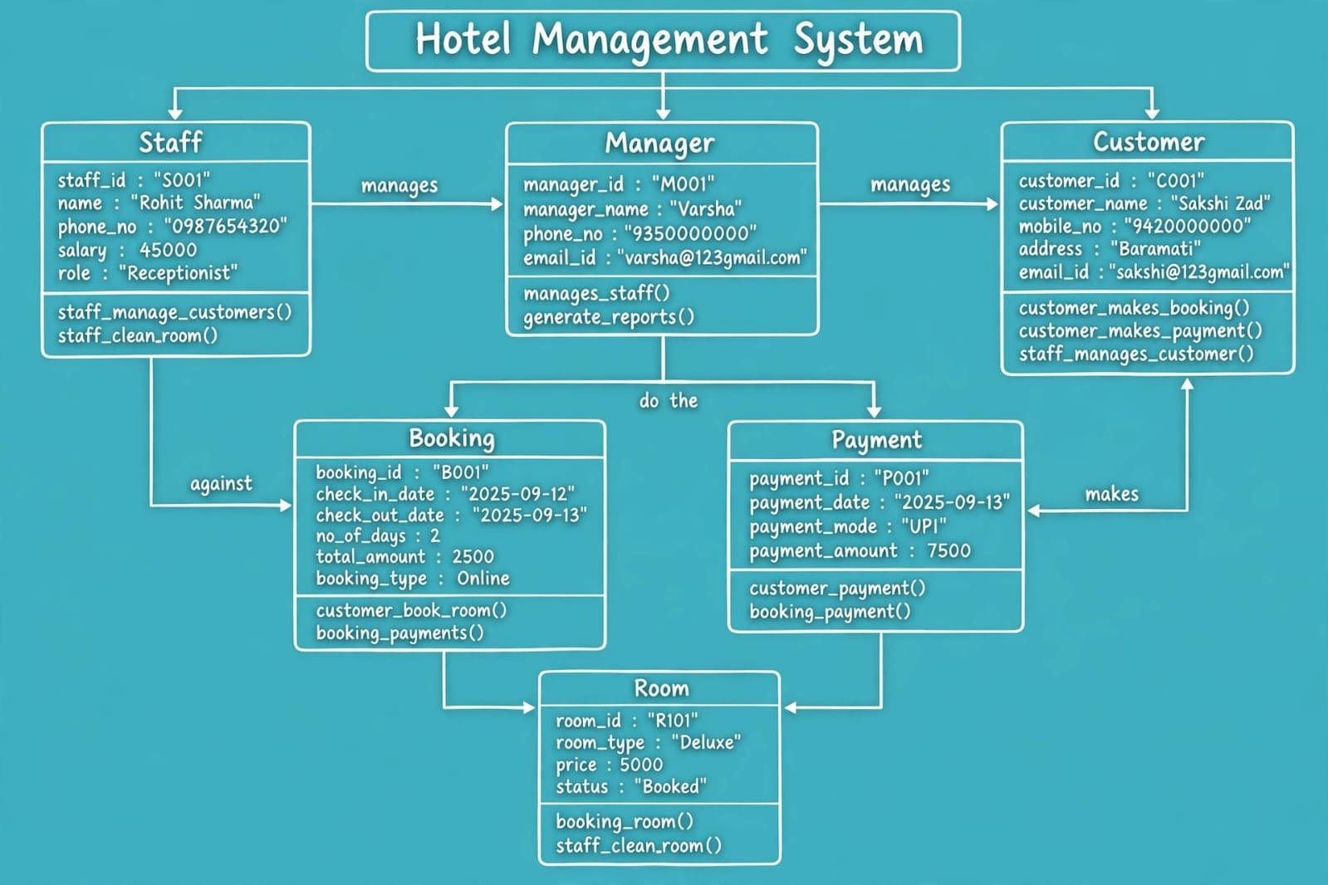
OBJECT DIAGRAM

Slide 10
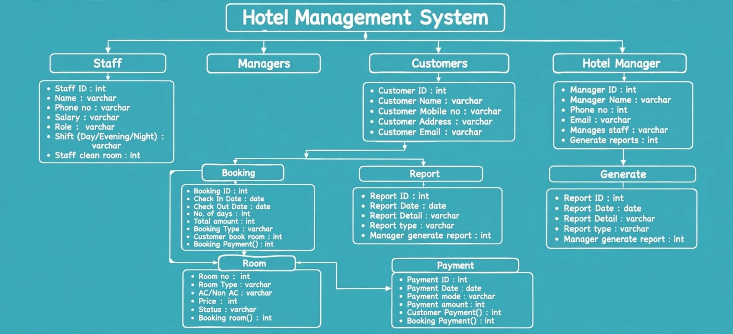
CLASS DIAGRAM

Slide 11
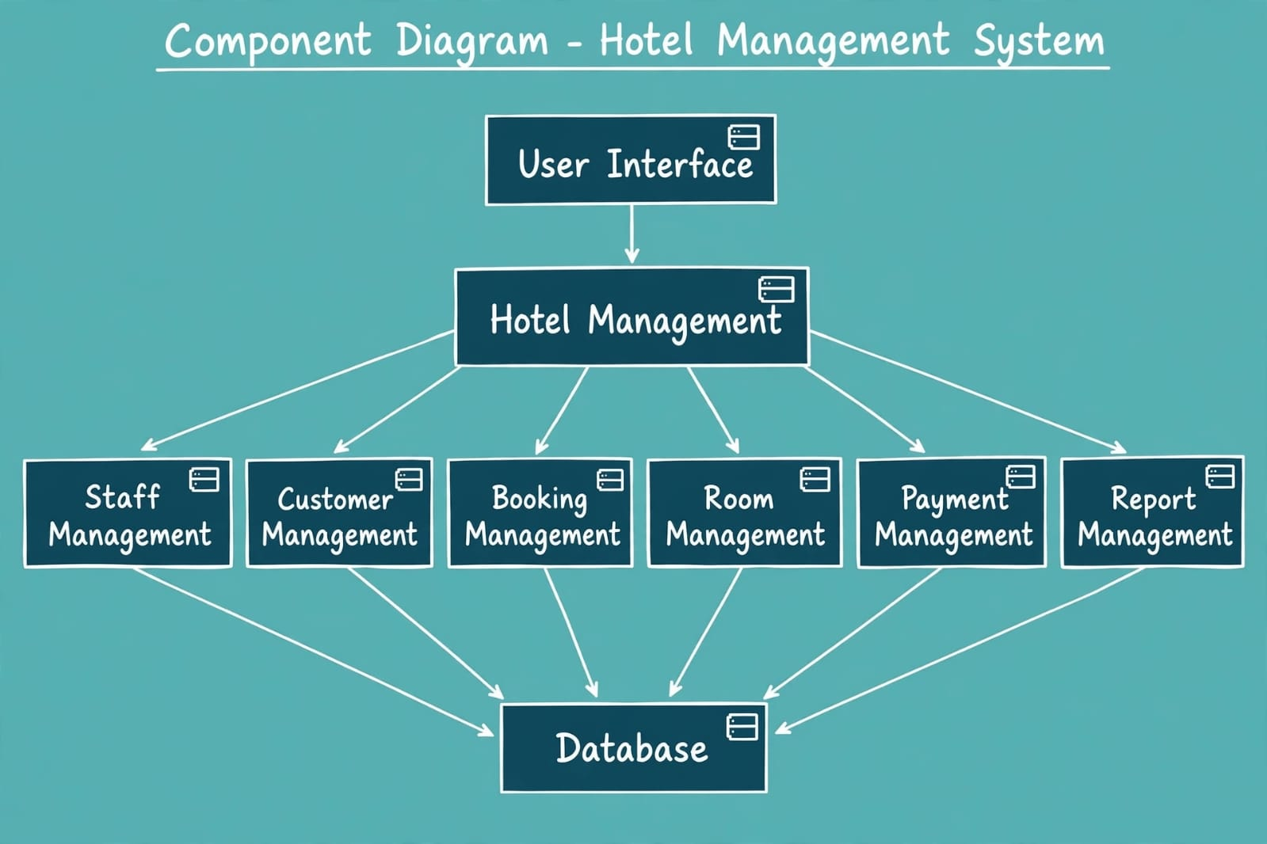
COMPONANT DIAGRAM

Slide 12
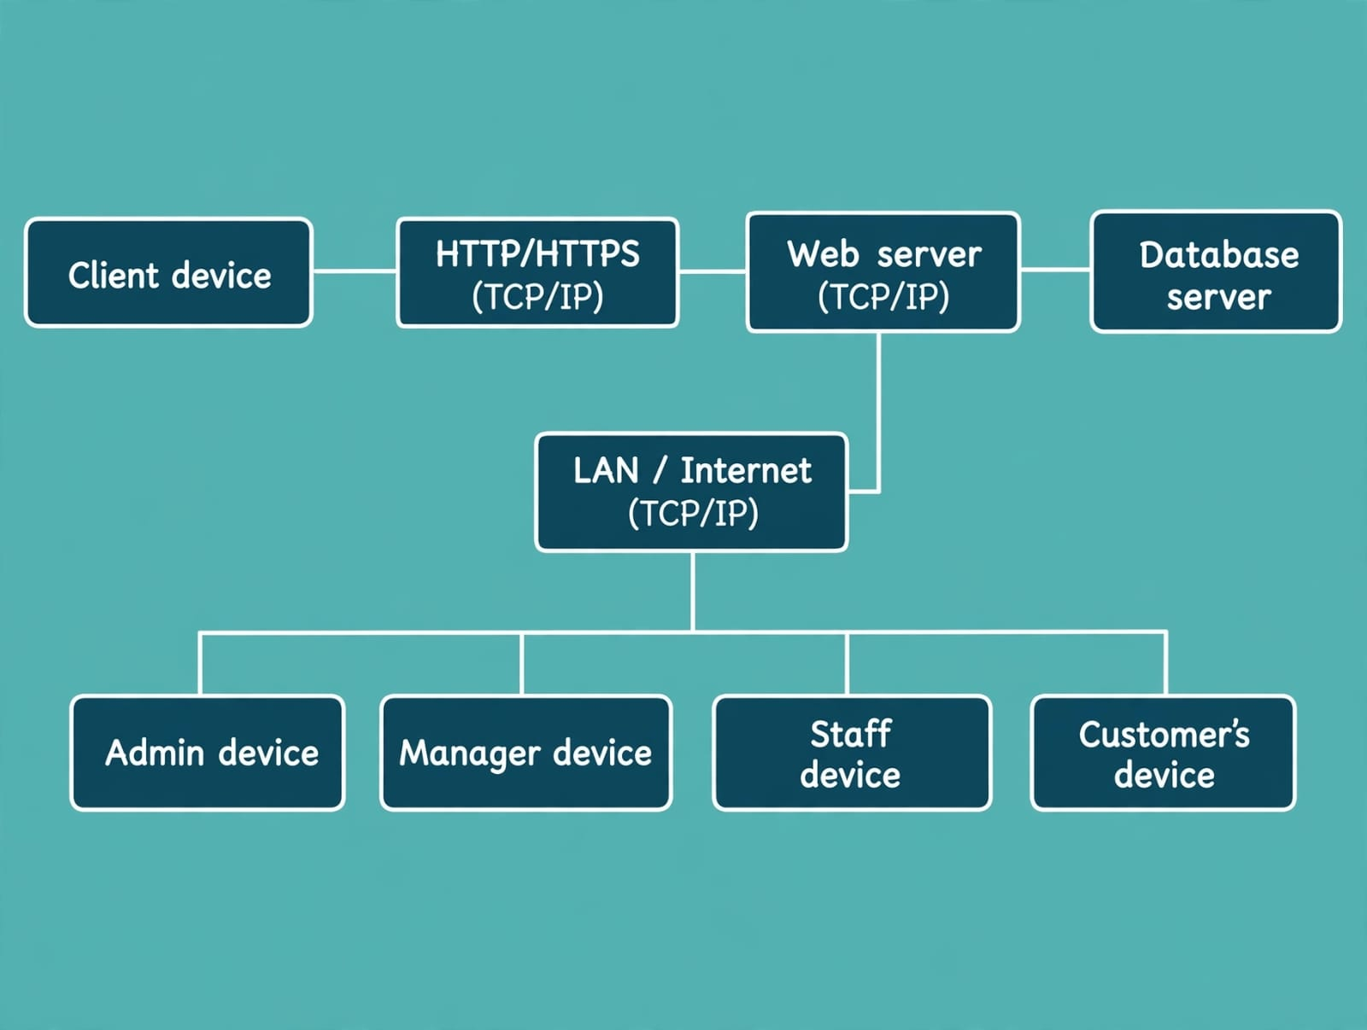
DEPLOYMNT DIAGRAM

Slide 13
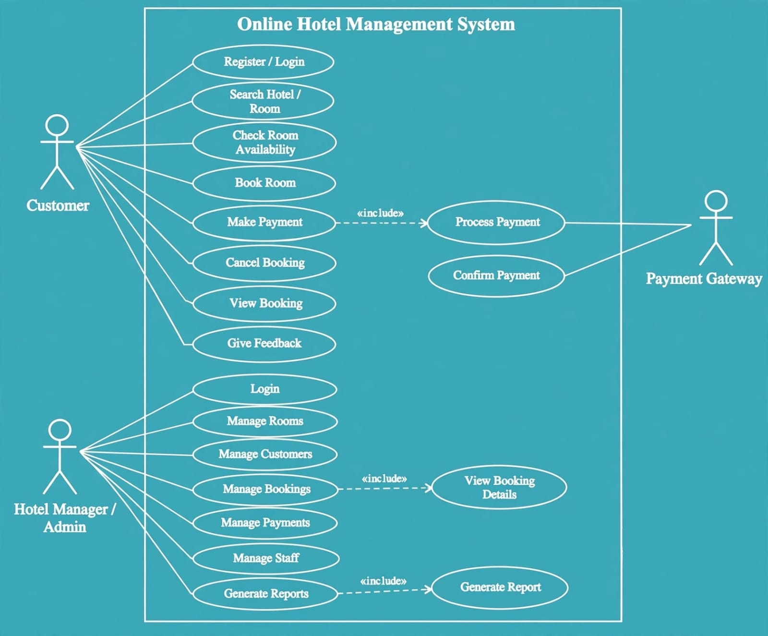
USE CASE DIAGRAM

Slide 14
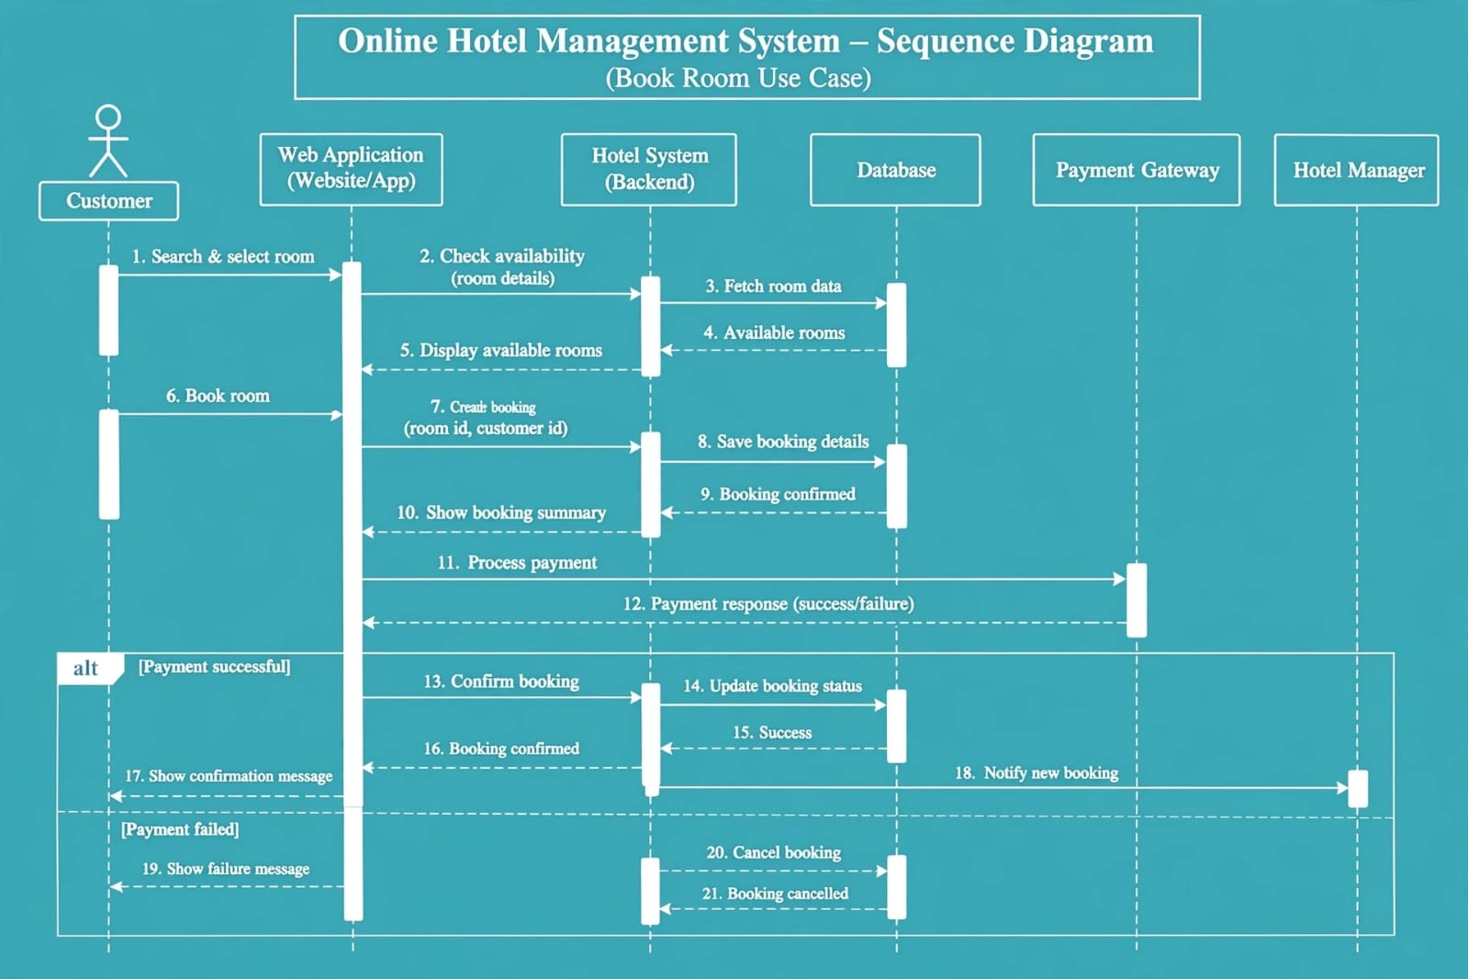
SEQUENCE DIGARAM

Slide 15
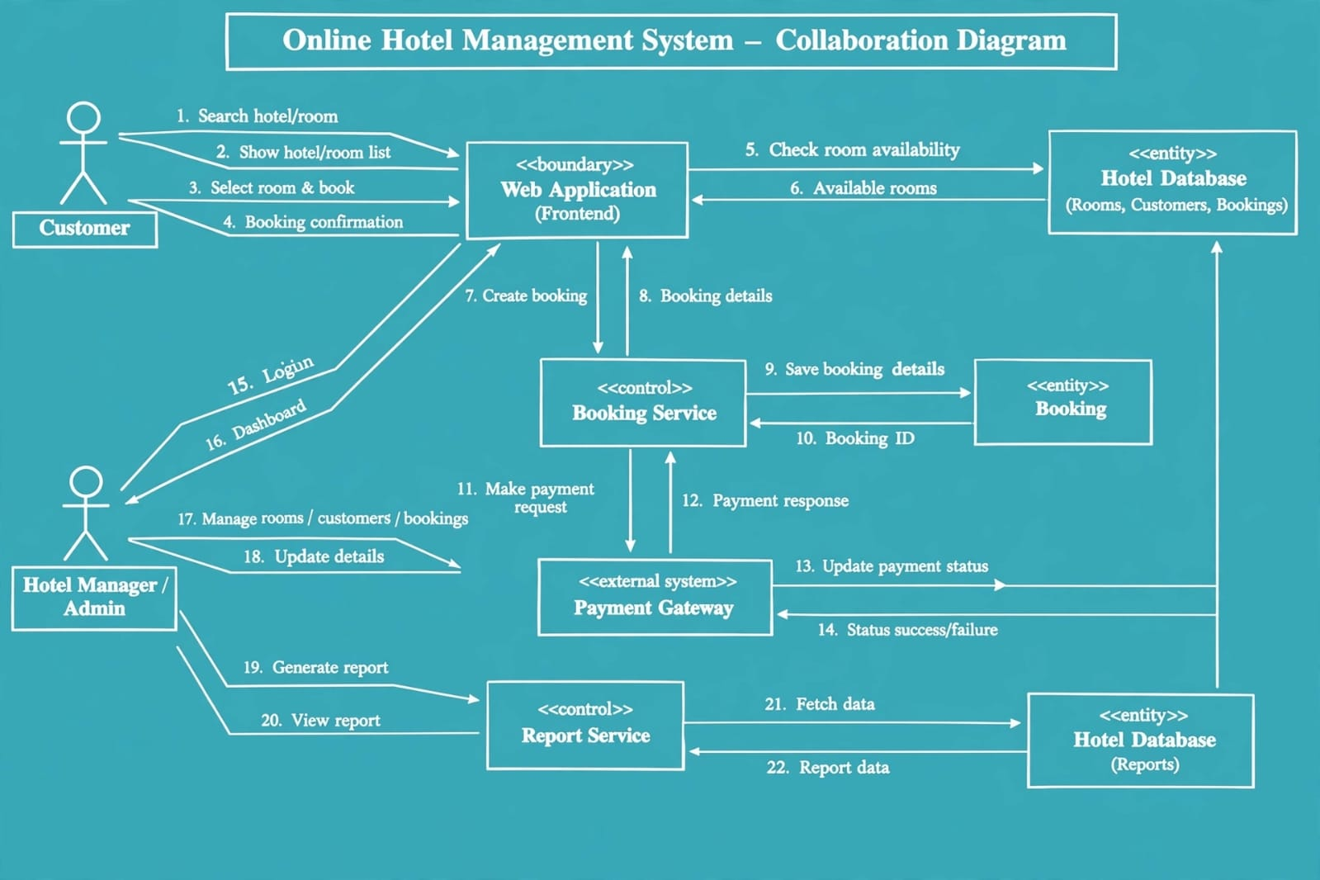
COLLABRATION DIAGRAM

Slide 16
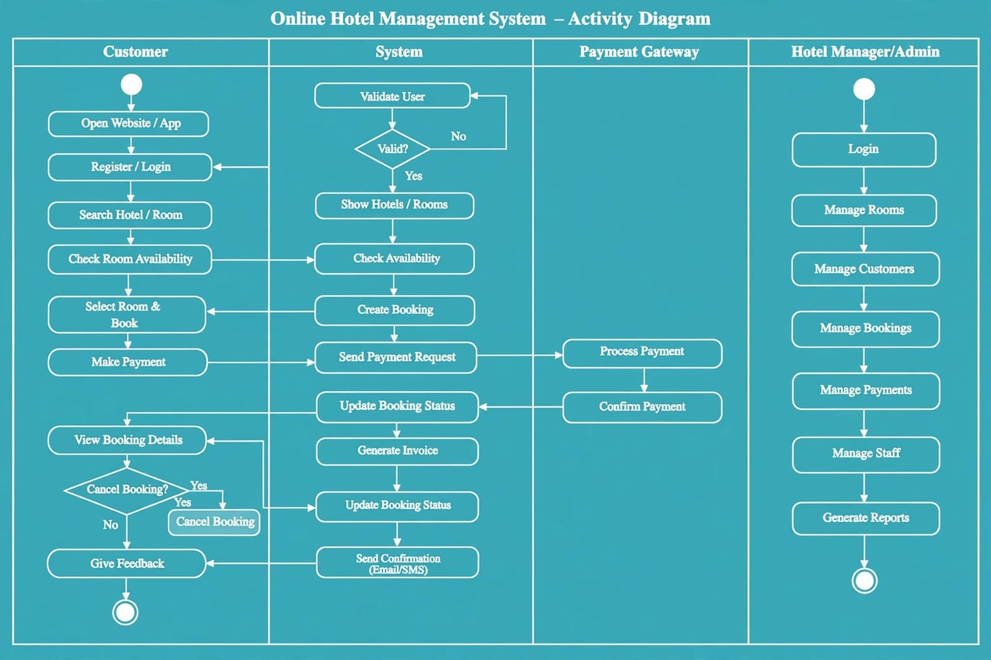
ACTIVITY DIAGRAM

Slide 17
Thank You

